Slide 1
Lecture-12
Democracy

Slide 2
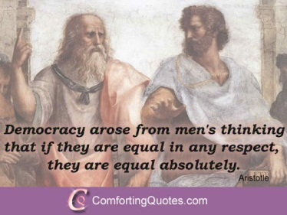
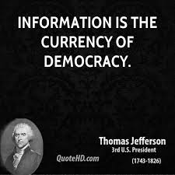

Slide 3
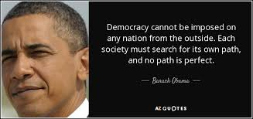
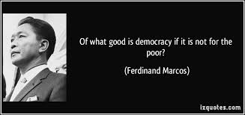

Slide 4
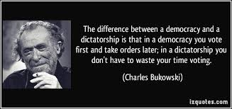
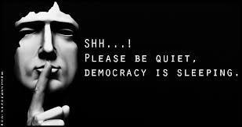

Slide 5

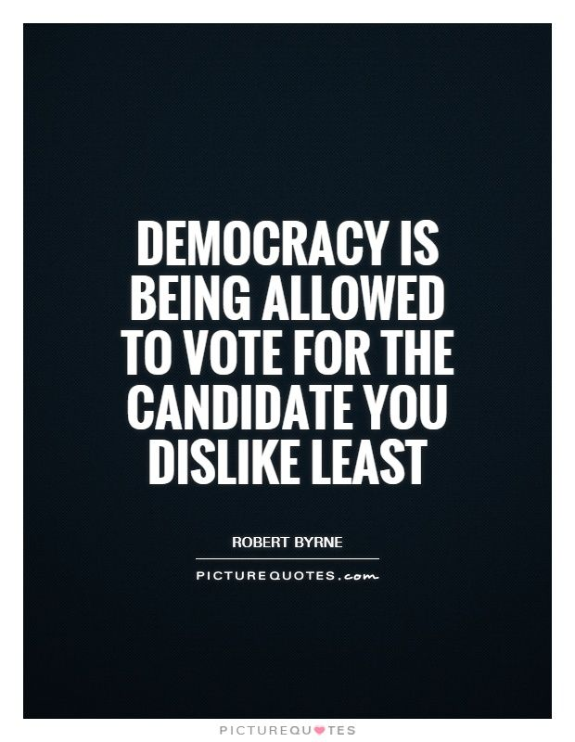

Slide 6
Definition of Democracy:
The term democracy is derived from two Greek words-
‘demos’ meaning the people &‘kratos’ for power. Thus, the
etymological meaning of Democracy is “Power of the people”.
President Abraham Lincoln defines-
Democracy is a government of the people, by the people and for the
people.
Prof. Seeley says-
“Democracy is a government in which everybody has a share”.
Jon. Roper defines-
“Democracy is not majority rule: democracy is diffusion of power,
representation of interests and recognition of minorities.”
According to Sryce,
“Democracy is that form government in which the ruling power of a
state is legally vested, not in any particular class or classes but in the
members of the community as a whole”.

Slide 7
Characteristics or Basic Principles of Democracy
Liberty: The main basis of democracy is liberty and equality. The people enjoy maximum liberty and equality because criticism of the people is not only tolerated in this system, but it is also encouraged.
Equality: Special emphasis is laid on equality in democracy and there is no disparity among the people on the basis of caste, creed, religion and position or status.
Fraternity: Democracy can become successful only in a peaceful atmosphere; otherwise democracy has to face many difficulties.
The people as ultimate source of sovereignty: In a democracy, people are the ultimate source of sovereignty, and the government derives its power from them. For this purpose elections take place in democracies at certain intervals.

Slide 8
Characteristics or Basic Principles of Democracy
Fundamental rights to the people: In a democracy people are given fundamental rights because in the absence of these rights the development of an individual is not possible.
Independence of Judiciary: In a democracy, it is responsibility of the judiciary to protect the fundamental rights of the people.
The people are considered as an end and state as the means in a democracy: This is one of the main characteristics of democracy that individual is a mean and the state is an end. It means that the state makes use of the individual for its own interest.
Welfare State: Democracy is a welfare state and in it special attention is paid to the welfare of the people as a whole and not to a particular class.
Free elections: The right of the people to have free and open elections. In free elections: everyone’s vote carries the same weight (one person, one vote). Candidates can express their views freely through democracy.

Slide 9
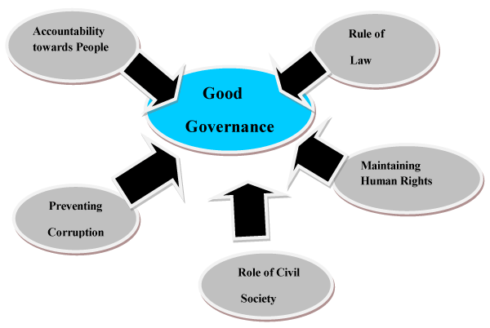
Conditions for the success of Democracy or Good Governance

Slide 10
Conditions for the success of Democracy or Good Governance
Sound System of Education: Where there is illiteracy, it becomes difficult to make democracy successful because many qualities are needed to make democracy a success.
Enlightened citizenship: People should have the knowledge of their rights and duties to make democracy as success.
Political Awakening: It is essential to inculcate political awakening among the citizens to make democracy a success. Where there is no political awakening, the citizens fail to understand the political problems.
Freedom: Democracy guarantees the citizens the freedom of expression, freedom of profession, freedom of religion and freedom to form associations.
Political security, good administration, economic prosperity and wise leadership: Efficient administration is another condition for the success of a democracy. In fact, the success of democracy depends upon efficient administration.

Slide 11
Conditions for the success of Democracy or Good Governance
Equality: Democracy does not recognize class distinctions. It is based on social, economic and political equality. In democracy all are equal before law and there is no discrimination on the basis of caste, colour, religion, sex and economic status.
Law and Order: The maintenance of law and order in society by the government is another essential condition for the success of democracy.
Spirit of Co-operation: Every democracy has to face many economic, social, religious and political problems. In dictatorship, these problems are solved by the dictator according to his own whim.
Decentralization of powers and local Self-Government: For the success of a democracy, decentralization of powers is essential.
High Moral Standard: The success of democracy also depends upon the high moral standard of the people as well as of the government.

Slide 12
Conditions for the success of Democracy or Good Governance
Social and Economic Security: Economic security is essential for the success of democracy. The people should be given the right to work and it is the duty of the government to provide them with suitable employment.
Tolerance and Spirit of Unity: It is the responsibility of the people to make democracy a success. For this, the spirit of tolerance and unity is needed.
Sound Party System: In a democracy difference in views is not only tolerated but it is encouraged, because constructive criticism has an important place in a democracy.
Written Constitution and Independent Judiciary: For the successful functioning of democracy, people are given fundamental rights and written constitutions are introduced with a view to checking autocratic activities of the government.
Independent, impartial and periodical elections: Independent, impartial and periodical elections help in establishing faith of the people and the opposition in democracy, otherwise the opposition party will not get an opportunity for forming, the government and there will be no respect for public opinion.

Slide 13
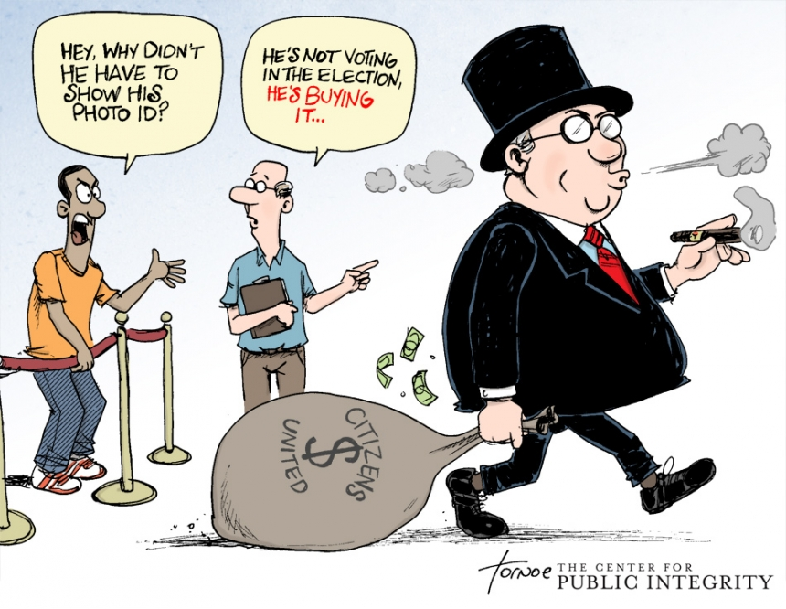

Slide 14
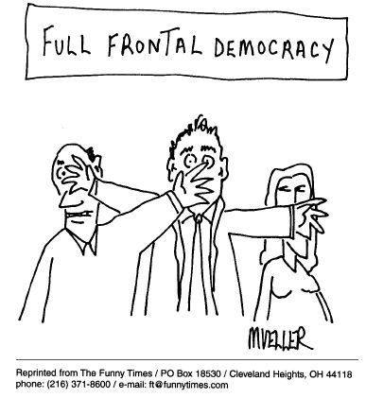

Slide 15
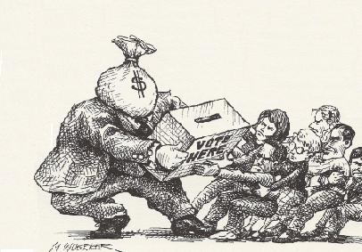

Slide 16
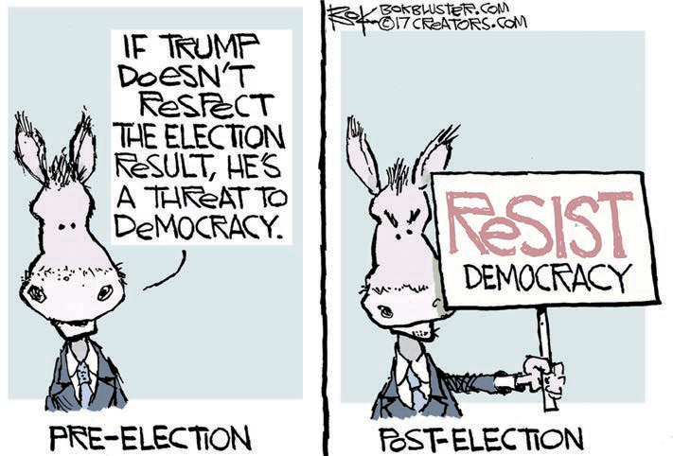

Slide 17
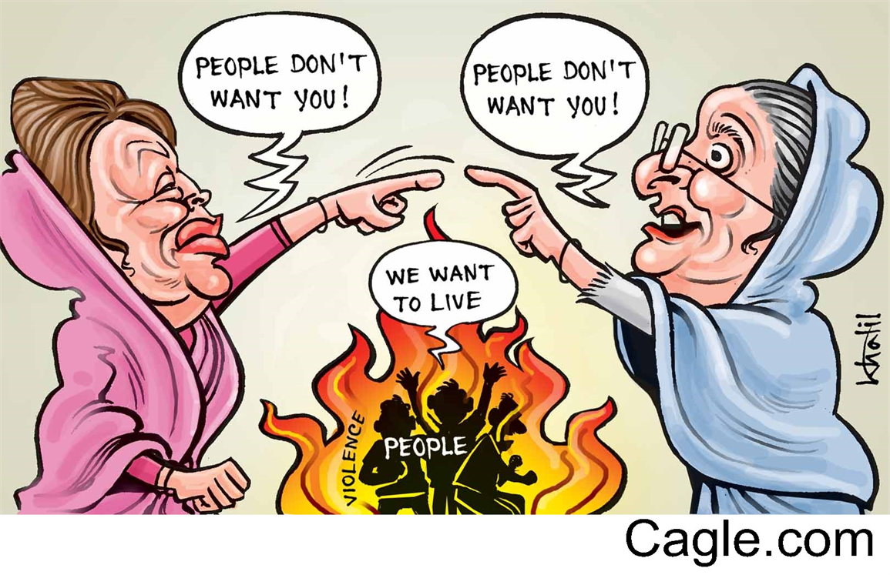

Slide 18
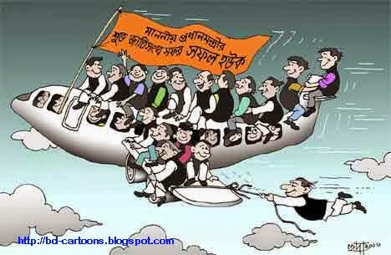
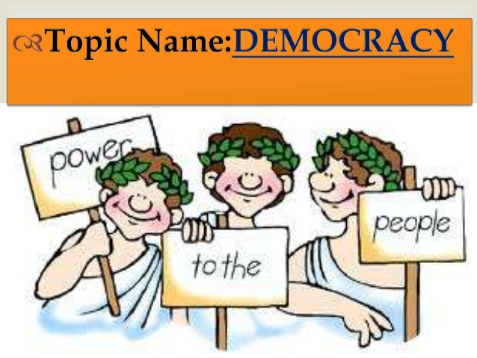

Slide 19
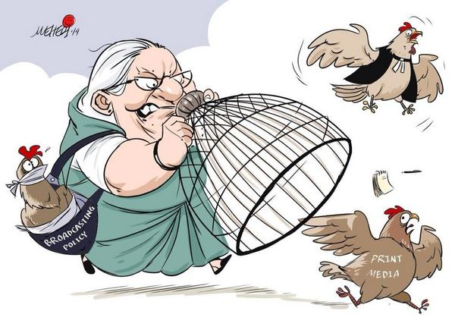

Slide 20
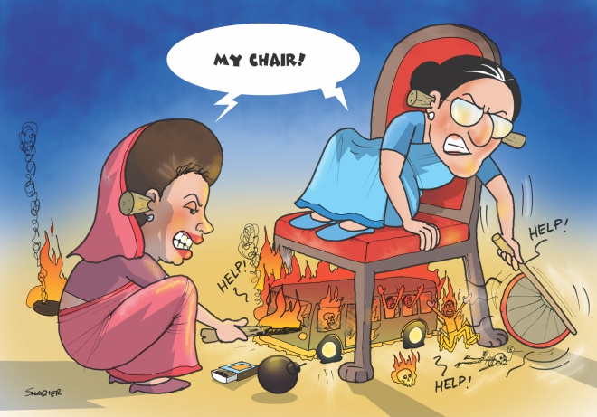
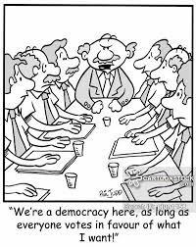

Slide 21

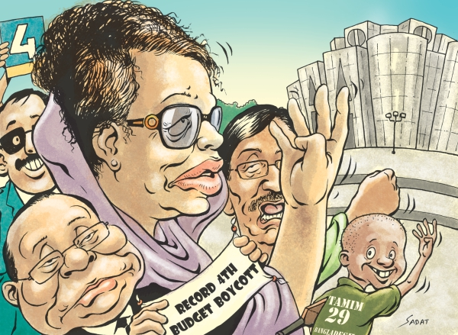

Slide 22
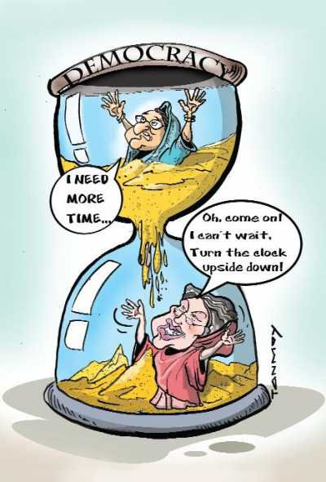
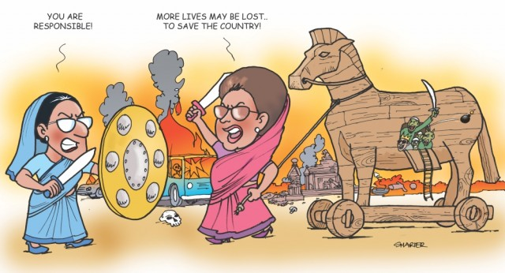

Slide 23
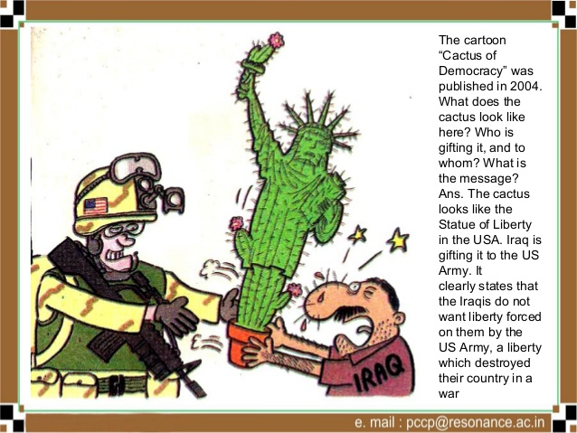

Slide 24
